Slide 1

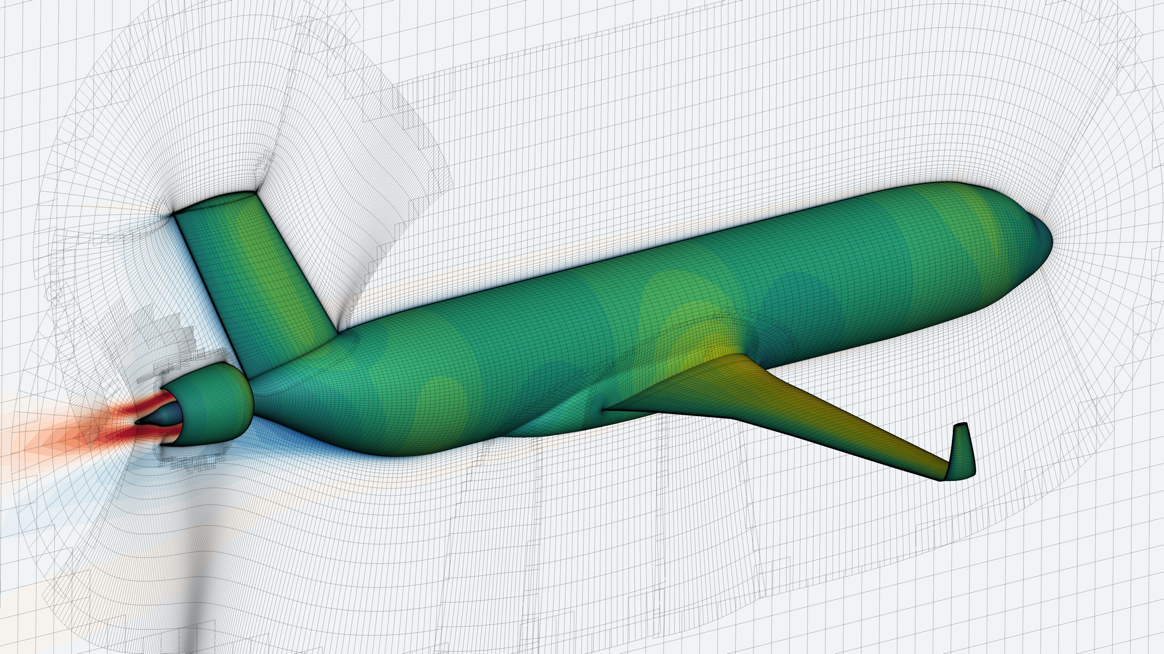
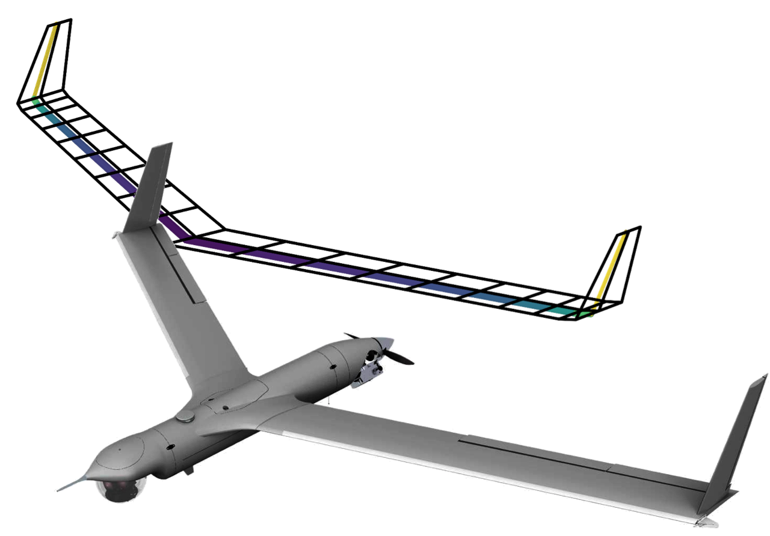

Getting started with
John Jasa johnjasa@umich.edu
Shamsheer Chauhan sschau@umich.edu
Joaquim R.R.A. Martins jrram@umich.edu
University of Michigan MDO Lab

Slide 2
Acknowledgements
Ben Brelje, PhD candidate at University of Michigan MDO Lab for creating version 0 of this training
Justin Gray, Engineer and team lead of OpenMDAO at NASA Glenn for refining this workshop
NASA ARMD’s TTT Project has supported OpenMDAO development since 2008

Slide 3
Download these slides and tutorial scripts from GitHub
https://github.com/johnjasa/openmdao_training

Slide 4
The OpenMDAO and MAUD papers are worthwhile references
J. S. Gray, J. T. Hwang, J. R. R. A. Martins, K. T. Moore, and B. A. Naylor, “OpenMDAO: An Open-Source Framework for Multidisciplinary Design, Analysis, and Optimization,” Structural and Multidisciplinary Optimization, 2019.
J. T. Hwang and J. R. R. A. Martins, “A computational architecture for coupling heterogeneous numerical models and computing coupled derivatives,” ACM TOMS, 2018.

Slide 5
Levels of expertise suggested to use OpenMDAO
Intermediate
Novice

Slide 6
Levels of expertise suggested to use OpenMDAO like a pro
Roald Amundsen at exploring
Intermediate
Novice

Slide 7
OpenMDAO is an open-source framework for efficient MDAO
Developed and supported a team at NASA Glenn since 2008
Apache 2.0 license is very permissive (no “copyleft”)
Fast enough for high-fidelity, expensive problems but easy enough for cheap conceptual models
Can be used as a framework, or a low level library for building stand alone codes

Slide 8
OpenMDAO is a reasonable choice for a wide array of MDAO problems
High-fidelity aeropropulsive optimization with RANS and CEA
Gray et al., 2018, AIAA Aviation

Slide 9
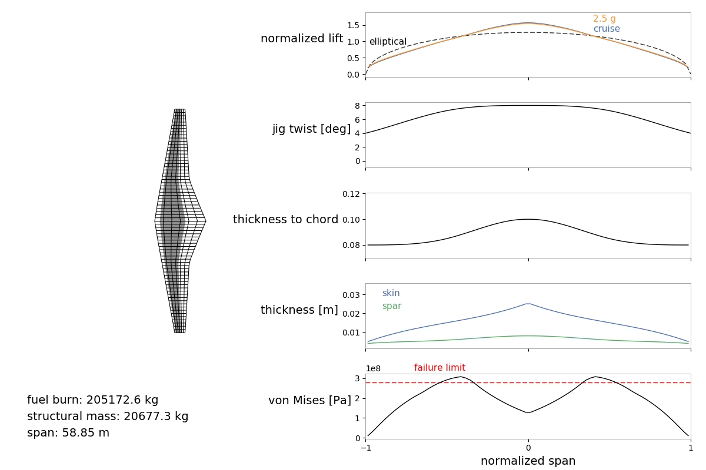
OpenMDAO is a reasonable choice for a wide array of MDAO problems
High-fidelity aeropropulsive optimization with RANS and CEA
Medium-fidelity aerostructural optimization (VLM/beam)
Chauhan and Martins, SMO 2019

Slide 10
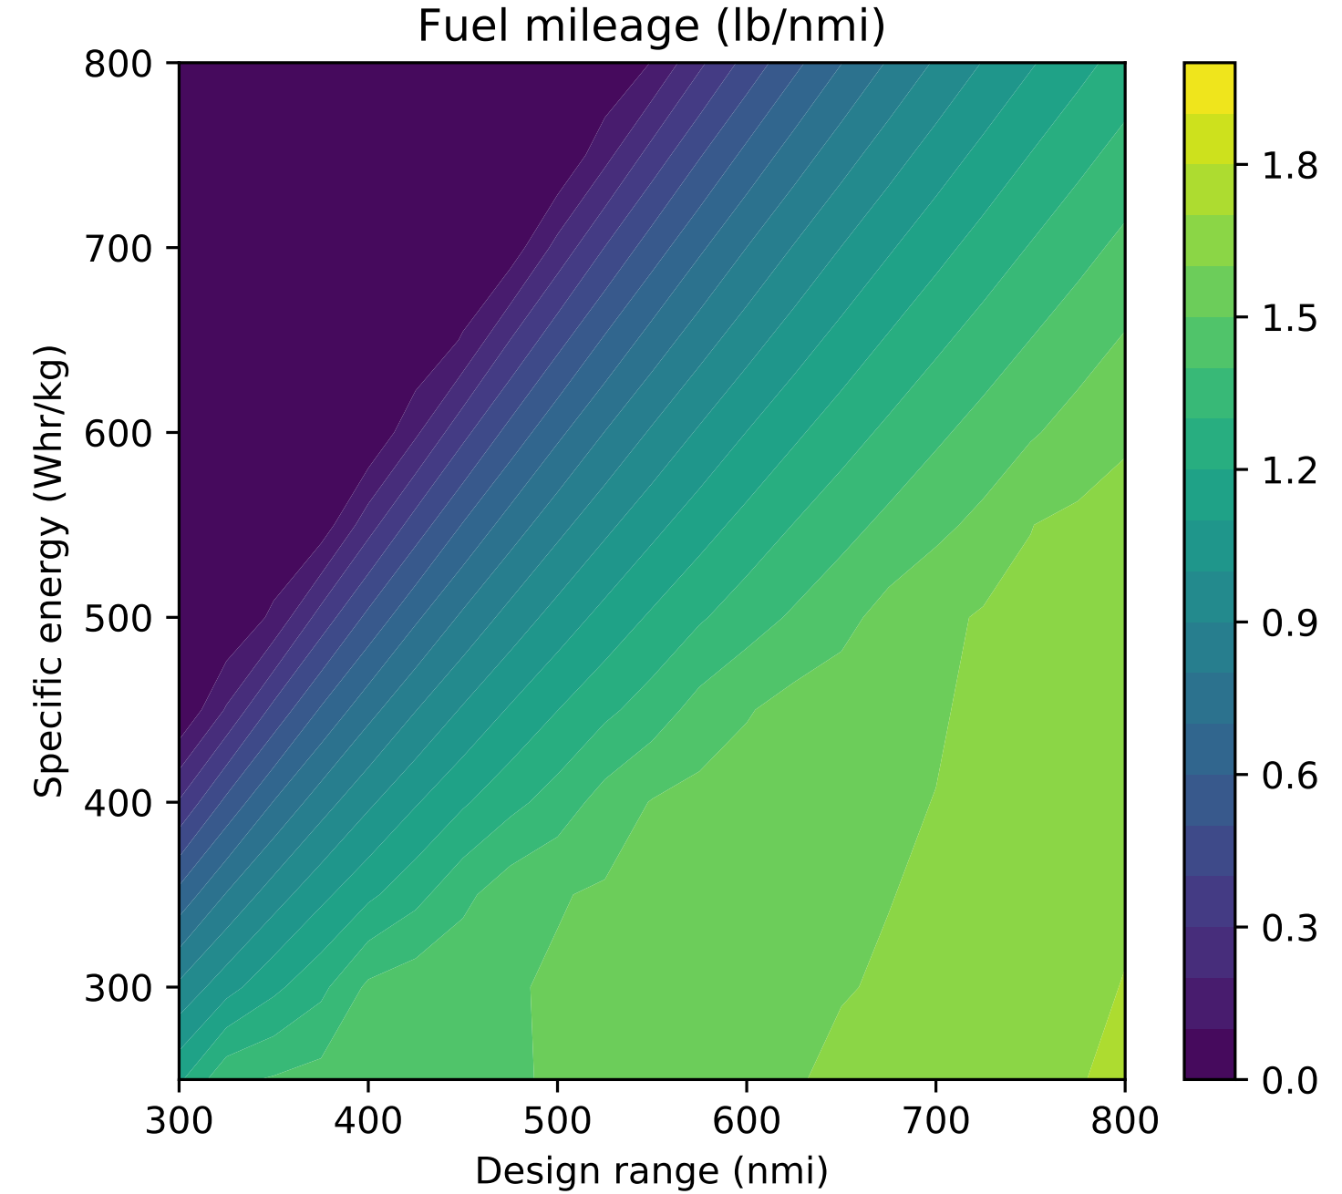
OpenMDAO is a reasonable choice for a wide array of MDAO problems
High-fidelity aeropropulsive optimization with RANS and CEA
Medium-fidelity aerostructural optimization (VLM/beam)
Conceptual-fidelity sizing and tradespace exploration
Brelje and Martins, EATS 2018

Slide 11
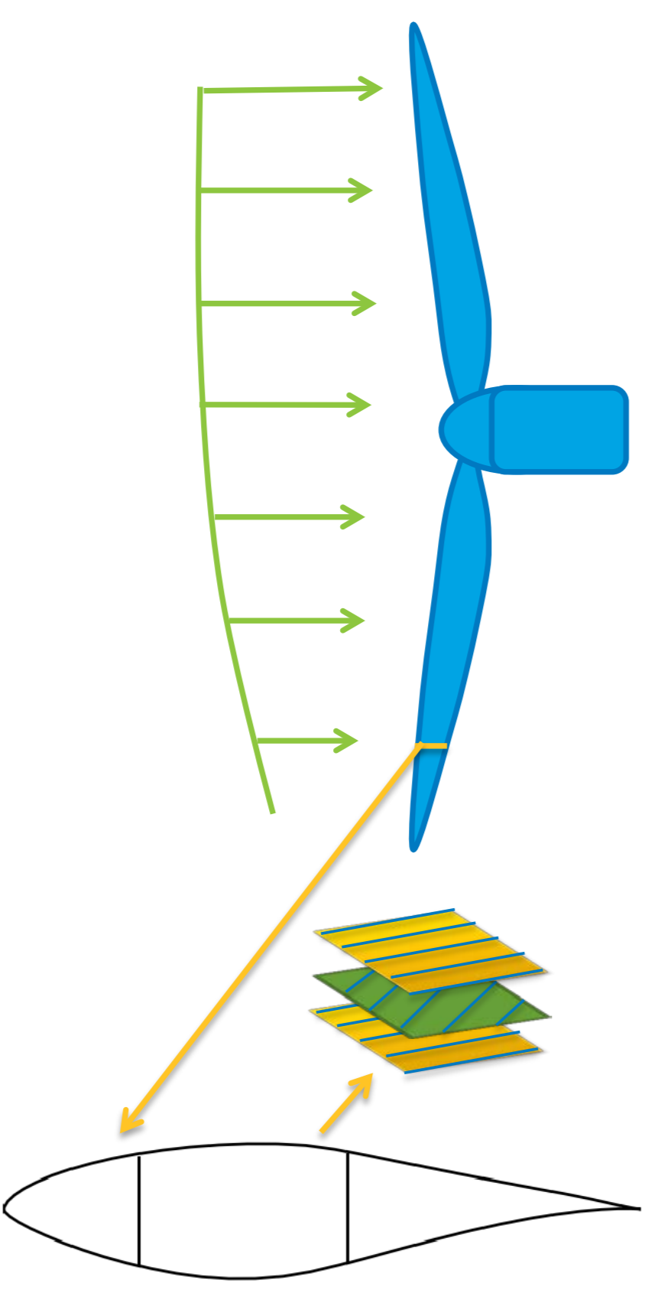
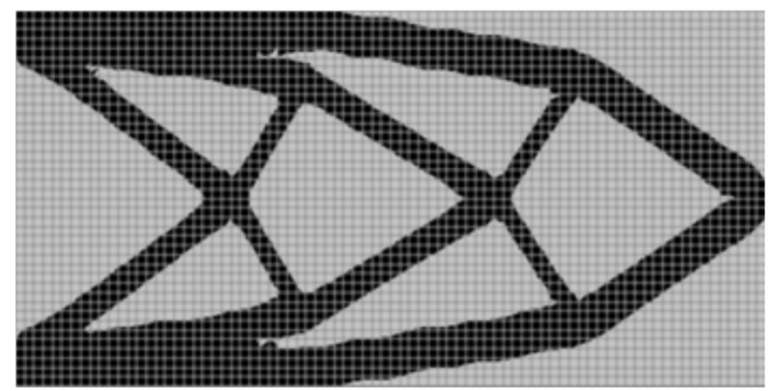
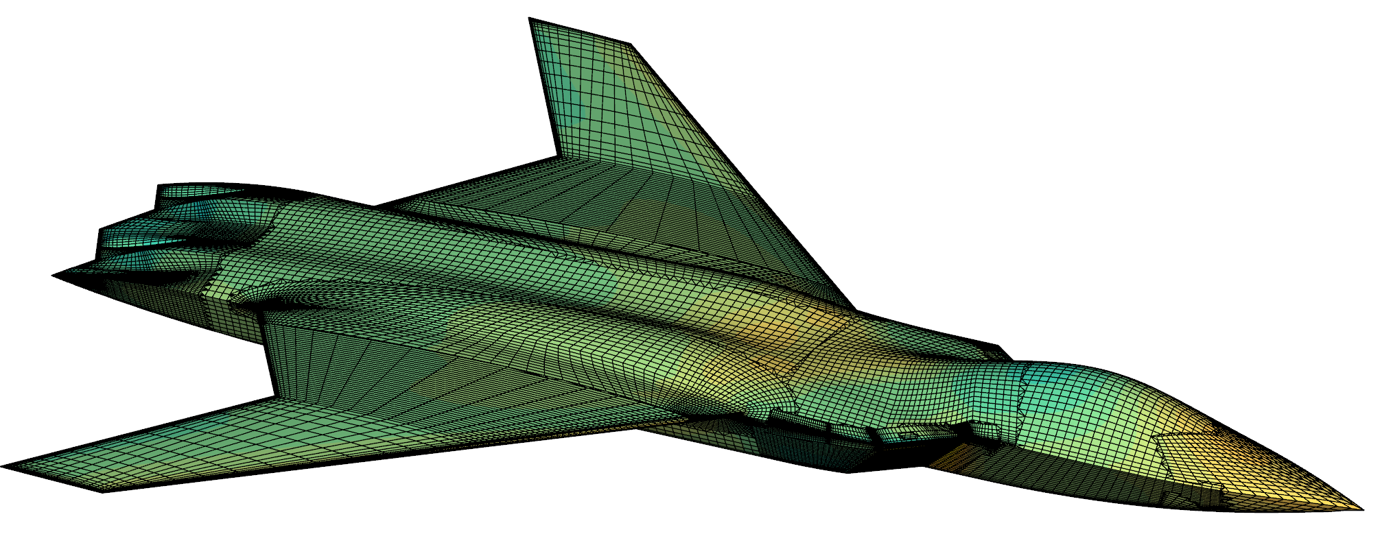
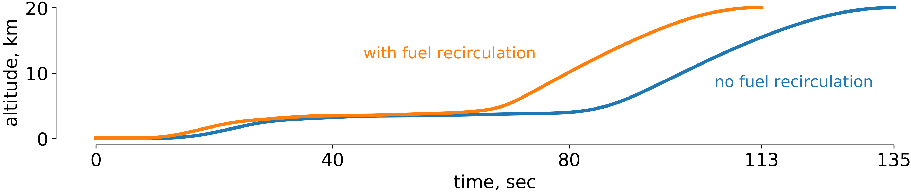
OpenMDAO is a reasonable choice for a wide array of MDAO problems
Chung et al., 2019, SMO
Dykes et al., 2015 NREL presentation
Jasa et al., 2018, AIAA Aviation

Slide 12
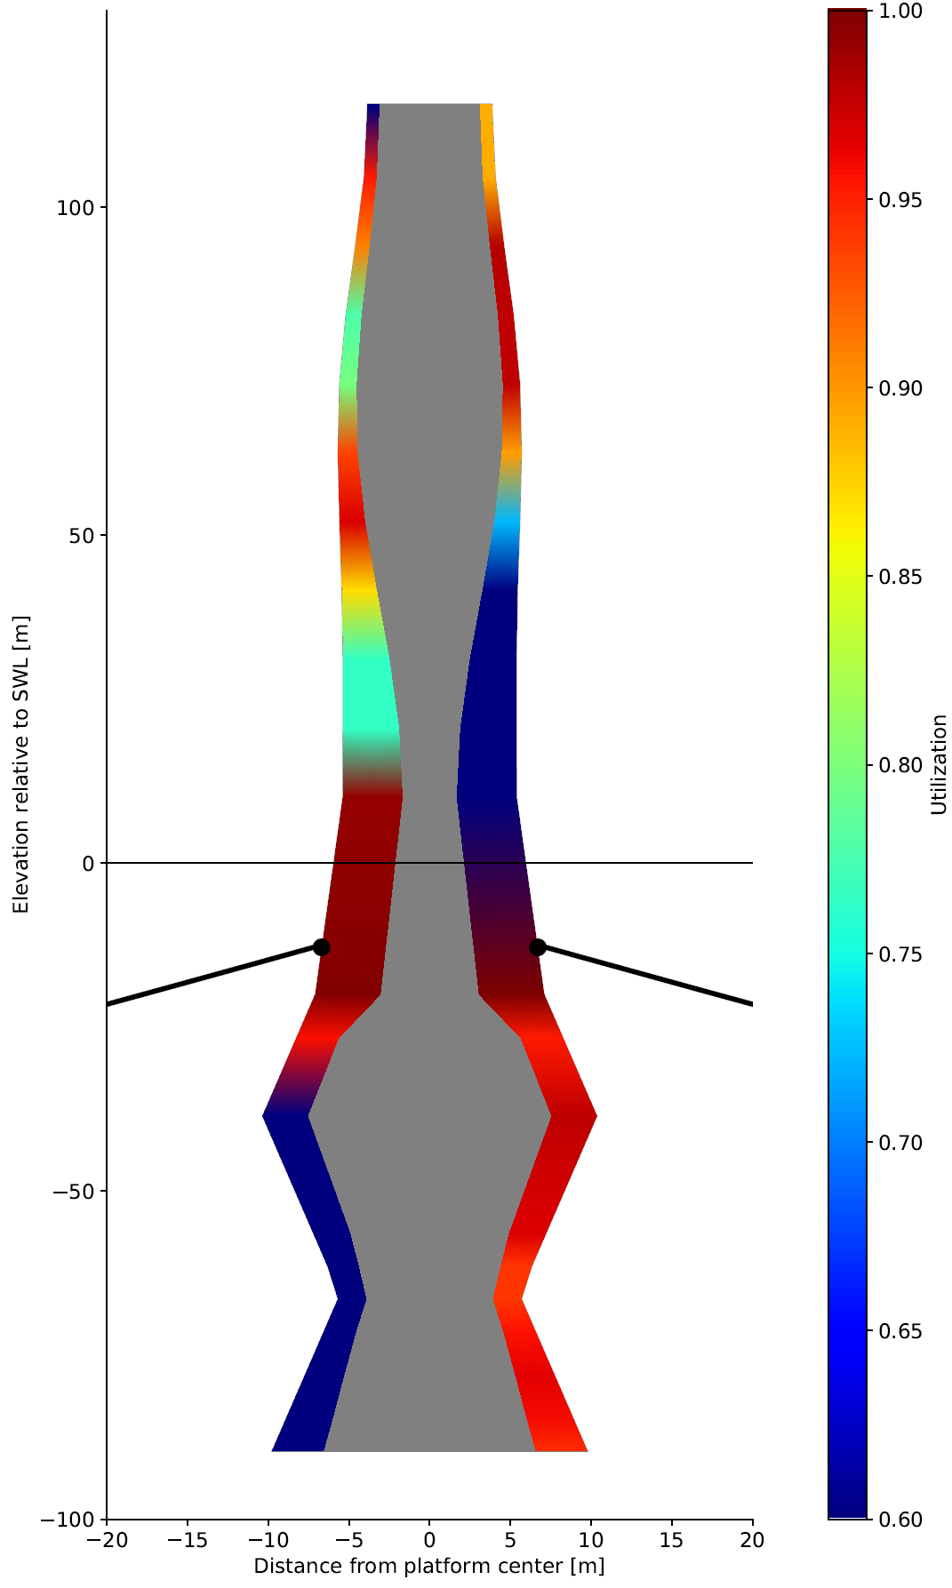
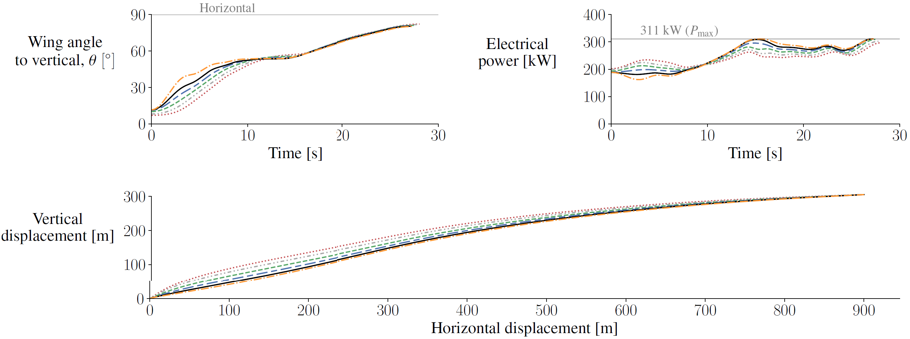
OpenMDAO is a reasonable choice for a wide array of MDAO problems
Chauhan and Martins, Journal of Aircraft 2019
Hegseth and Bachynski, 2019

Slide 13
Goals for today
Learn enough to run a useful OpenMDAO model
Gain some intuition about the operating theory
Get excited about using analytic derivatives for optimization

Slide 14
Brief introduction to optimization terms
What is an optimization problem?
Gradient-free vs gradient-based optimizers
How to get derivatives

Slide 15
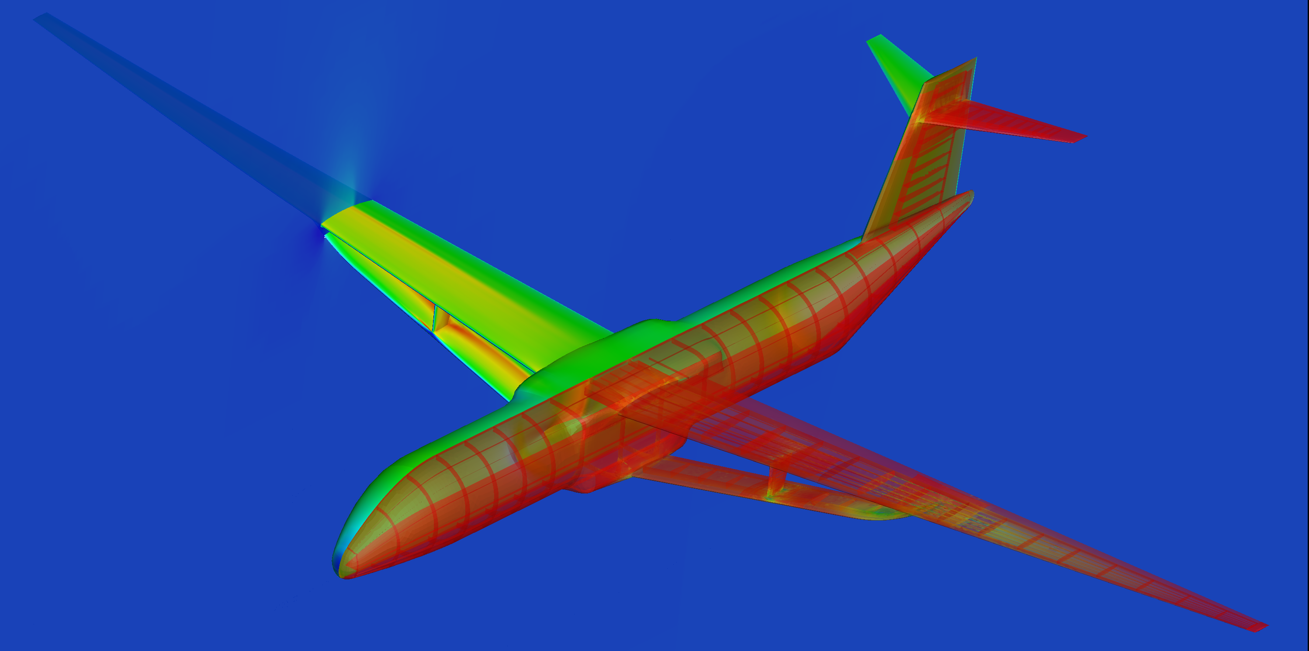
Numerical optimization provides a way to
fully automate the design process
Wing span
Airfoil shapes
Structural sizing
Fuel burn
Structural stresses
Design changes
Design optimization problem:
minimize
with respect to
subject to
f(x)
x
c(x) ≤ 0
objective
design variables
constraints
Notes:
The end goal for these simulations is to perform design, so once a simulation becomes mature, it is logical to include it in a numerical optimization loop.
Numerical simulations are particularly valuable for design, because we change the design more easily in the computer model, and revaluate the performance.

Slide 16
Numerical optimization provides a way to
fully automate the design process
Wing span
Airfoil shapes
Structural sizing
Fuel burn
Structural stresses
Design changes
Reformulate optimization problem
Post-optimality studies
Notes:
The end goal for these simulations is to perform design, so once a simulation becomes mature, it is logical to include it in a numerical optimization loop.
Numerical simulations are particularly valuable for design, because we change the design more easily in the computer model, and revaluate the performance.

Slide 17
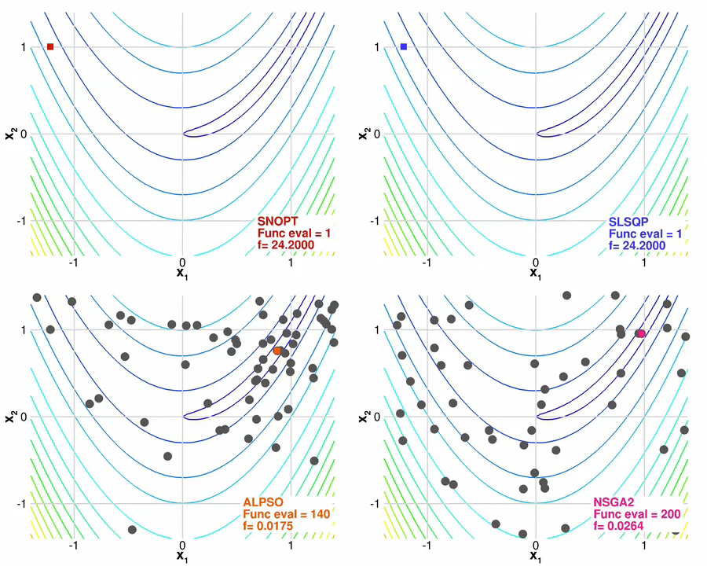
Gradient-based methods take
a more direct path to the optimum
Gradient-based
Gradient-free
Notes:
In general there are two approaches.

Slide 18
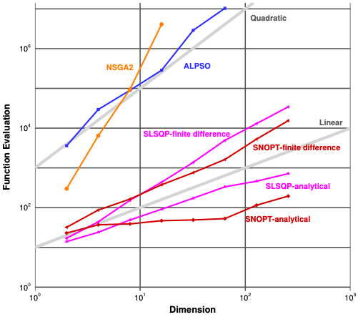
Gradient-based optimization is the only hope
for large numbers of design variables
[Lyu et al. ICCFD8-2014-0203]
Notes:
Gradient-based scale better and are the only practical option for certain problems.
Given the large number of design variables (100’s to 1000’s), gradient-based optimization is our only hope to solving these problems.
Furthermore, it pays to use efficient methods for computing the gradients.

Slide 19
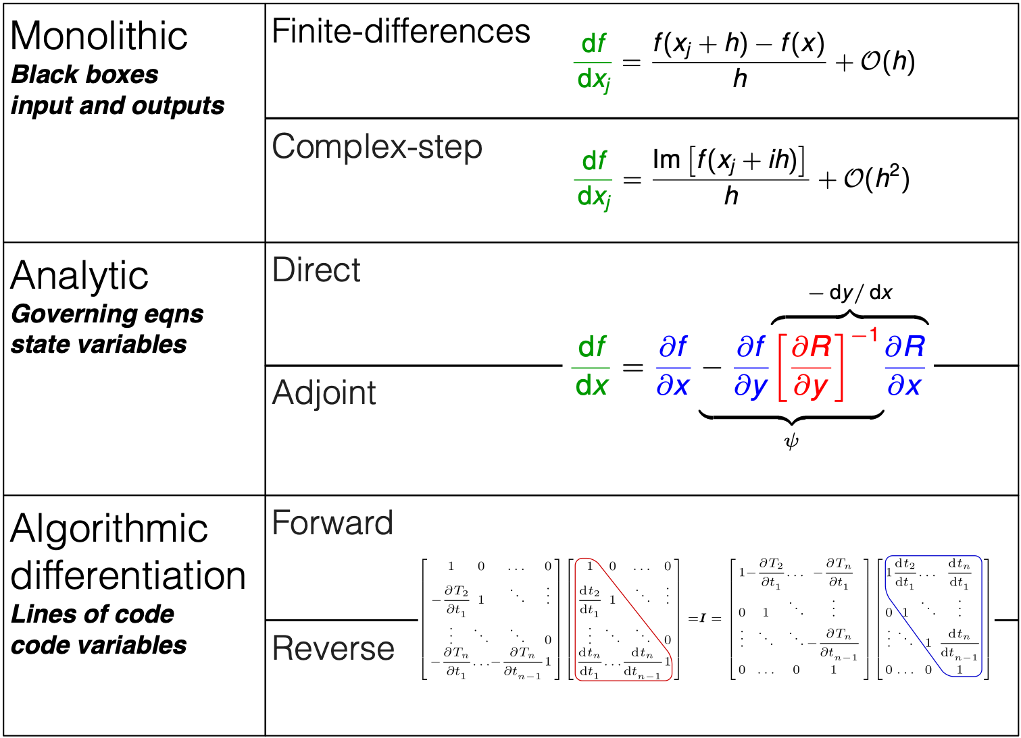
Methods for computing derivatives
[Martins et al., ACM TOMS, 2003]
[Martins and Hwang, AIAA Journal, 2013]
Notes:
Here is a quick overview of the different methods that are available.
Finite differences are popular, but suffer from accuracy problems. They are also not efficient, since they require at least one analysis for each design variable.
Only two of them scale well with the number of variables: adjoint methods, and reverse mode AD.

Slide 20
Overview of today’s activities
OpenMDAO intro and basics
Lab 0: Explicit components and connections
Using solvers with implicit models
Lab 1: Comparing gradient-free and gradient-based solvers
Optimization with and without analytic derivatives
Lab 2: Optimizing the thickness distribution of a simple beam
Wrapping external codes
Lab 3: Wrapping external codes as explicit and implicit components

Slide 21
OpenMDAO intro and Basics
Intro and terminology
Building explicit components and connecting them together
Lab 0: Implementing a simple explicit calculation (Breguet Range)

Slide 22
OpenMDAO has nice features
Units
Conversions
(In)compatibility checks

Slide 23
OpenMDAO has nice features
Units
Conversions
(In)compatibility checks
Automatic checks for unconnected inputs

Slide 24
OpenMDAO has nice features
Units
Conversions
(In)compatibility checks
Automatic checks for unconnected inputs
Interactive N2 diagrams

Slide 25
OpenMDAO has nice features
Units
Conversions
(In)compatibility checks
Automatic checks for unconnected inputs
Interactive N2 diagrams
Models are Python objects (inheritance!)

Slide 26
OpenMDAO has advanced numerical methods
Efficient solvers for implicit systems
Newton solver
Nonlinear block Gauss-Seidel

Slide 27
OpenMDAO has advanced numerical methods
Efficient solvers for implicit systems
Newton solver
Nonlinear block Gauss-Seidel
Derivative computation (for gradient-based opt.)
Forward and reverse analytic
Finite difference or complex step
Mixture of all!

Slide 28
OpenMDAO has advanced numerical methods
Efficient solvers for implicit systems
Newton solver
Nonlinear block Gauss-Seidel
Derivative computation (for gradient-based opt.)
Forward and reverse analytic
Finite difference or complex step
Mixture of all!
MPI parallelization

Slide 29
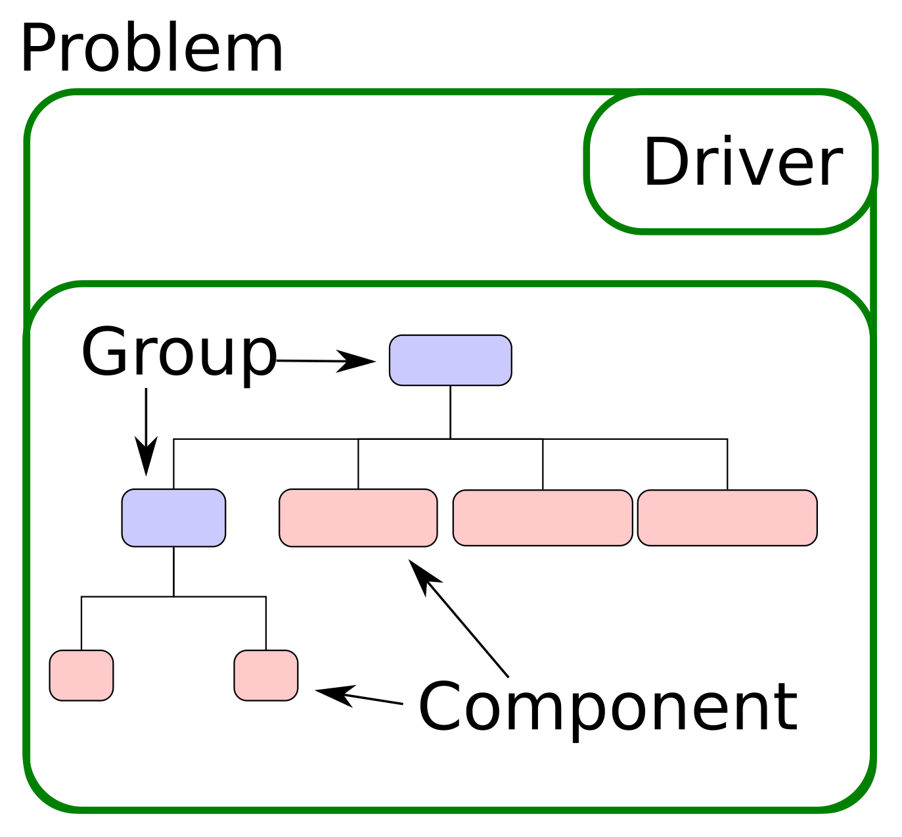
OpenMDAO problem hierarchy
Components implement the actual model computation

Slide 30
OpenMDAO problem hierarchy
Components implement the actual model computation
Groups organize the model and enable hierarchical solver strategies

Slide 31
OpenMDAO problem hierarchy
Components implement the actual model computation
Groups organize the model and enable hierarchical solver strategies
Drivers iteratively execute the model (optimizers and DOEs)

Slide 32
OpenMDAO problem hierarchy
Components implement the actual model computation
Groups organize the model and enable hierarchical solver strategies
Drivers iteratively execute the model (optimizers and DOEs)
Problem is the top-level container

Slide 33
Why use classes in object-oriented programming?
Convenient containers of data and methods
It allows inheritance of features
Can reuse component and group templates easily

Slide 34
ExplicitComponent class
Used for doing explicit calculations
Inputs → Outputs
Can be as simple as a one-line calculation, or as complex as an adjoint CFD solver

Slide 35
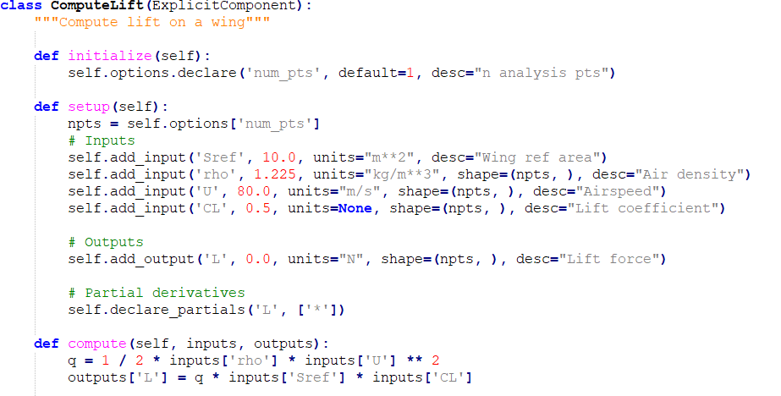

ExplicitComponent example
$$L=\frac{1}{2}ρU^{2}S_{ref}C_{L}$$

Slide 36
ExplicitComponent example
All your model components will subclass OpenMDAO base classes
$$L=\frac{1}{2}ρU^{2}S_{ref}C_{L}$$

Slide 37
ExplicitComponent example
Define any options / run flags which do not change during evaluation
$$L=\frac{1}{2}ρU^{2}S_{ref}C_{L}$$

Slide 38
ExplicitComponent example
Define model inputs, output, and (optionally) partial derivs using the setup() method. Called once before solve / optimization
$$L=\frac{1}{2}ρU^{2}S_{ref}C_{L}$$

Slide 39

ExplicitComponent example
$$L=\frac{1}{2}ρU^{2}S_{ref}C_{L}$$
Do the actual computation using compute(). Need to fill in values for all your declared outputs by the end of this method. Called every time the model is evaluated

Slide 40
ExplicitComponent example
Variable name
Default value (before model runs)
Units (need not match upstream)
Human-readable description (optional)
Variable dimension
(in this case, a n x 1 vector)
Will default to expecting user provided analytic derivatives, but we can specify `fd` later…

Slide 41
IndepVarComp example
indeps = self.add_subsystem('indeps', om.IndepVarComp())
indeps.add_output(‘h’, 10000, units=“ft“)
indeps.add_output(‘U’, 200, units=“kn")
indeps.add_output(‘Sref', 200, units=“ft**2”)
IndepVarComps only have only outputs; they do not take in any input variables
IVCs are used in an optimization context to allow the optimizer to control design variables

Slide 42
Groups: organizing components
Combine components into a Group to build organized models
Groups can hold other Groups, which allows hierarchal solution strategies
Groups can used to create portable chunks of analysis chains

Slide 43
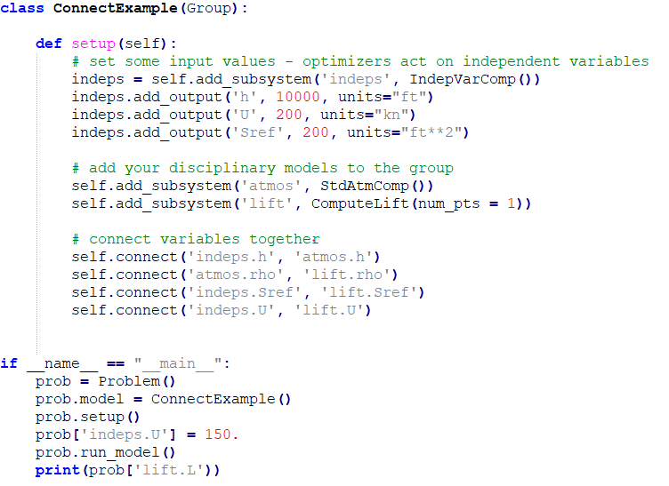
Grouping components
Define a model by subclassing Group
This is the model structure that is being connected
Sref
indeps
lift
U
h
atmos
rho

Slide 44
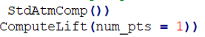
Grouping components
Include components using the add_subsystem(<name>, <component>) method
Python note:
These are instances of a component class

Slide 45
Grouping components
Your custom components can be defined in the same .py file, or imported from a package for modularity
Specify flags/options now

Slide 46
Grouping components
Sref
indeps
lift
U
h
atmos
rho
Connect parameters using the connect(<from>, <to>) method

Slide 47
Grouping components
Note the namespace / address string:
component_name.variable

Slide 48
Grouping components
When you run an MDA/MDO problem, you will add one top-level Group instance to the problem

Slide 49
Grouping components
The subgroups and components are executed in the order that they’re added to the system

Slide 50
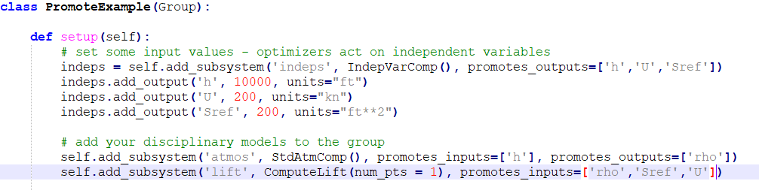
Another way to connect…
If parameters are widely used among many components, writing many connect() statements can be tedious
Variable promotion is another way to make connections

Slide 51
What does variable promotion do?
Creates an alias for the variable one level up in the namespace
(atmos.h → h)
(lift.rho → rho)
Automatically connects any matching I/O variable names
Promote variables with wildcard (e.g. *_in or just *)

Slide 52
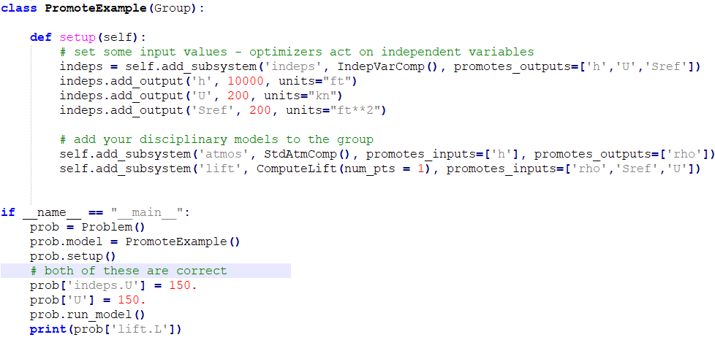
What does variable promotion do?
Input/output connection established automatically
Sref
indeps
lift
U
h
atmos
rho

Slide 53
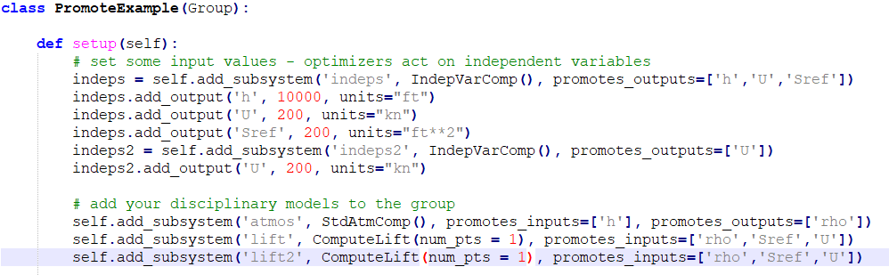
What does variable promotion do?
Multiple promoted outputs with same name: not allowed (will raise an exception)

Slide 54
What does variable promotion do?
Multiple promoted inputs with identical name: OK and encouraged
(all connections automatically made)

Slide 55
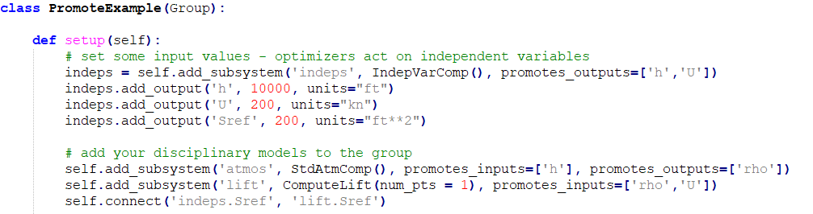
What does variable promotion do?
Mixing promotion with connect statements:
allowed / appropriate

Slide 56
Lab 0: Implementing simple explicit calculations (Breguet Range)
Step 1: Install OpenMDAO
Step 2: Write your first component
Step 3: World domination!

Slide 57
Lab 0.a: Install
Open cmd prompt
Internet install: pip install openmdao
Local Install:
cd to wherever OpenMDAO is downloaded: `pip install .`(note the period)
This installs from local source files, not PyPI
cd ../openmdao_training
python paraboloid.py
If this works without error, your installation should be good

Slide 58
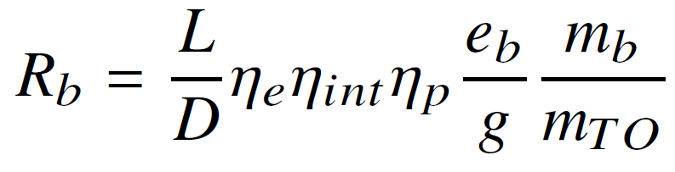

Lab 0.b: Aircraft Range
Open lab_0_template.py in a text editor or IDE and rename it to lab_0.py
The BreguetRange component implements the electric Breguet equation:
Your goal is to compute the maximum range of an airplane given a certain payload
$$m_{TO}=m_{empty}+m_{payload}+m_{battery}$$

Slide 59
Lab 0.b: Aircraft Range
Complete the TODOs in the BatteryWeight component
Complete the TODOs in the ElecRangeGroup definition by connecting the two components
cd into project folder to check and run the model:
openmdao view_model lab_0.py (creates model diagram)
python lab_0.py (runs the model)
Answer key in the lab_0_solution.py file (don’t cheat!)

Slide 60
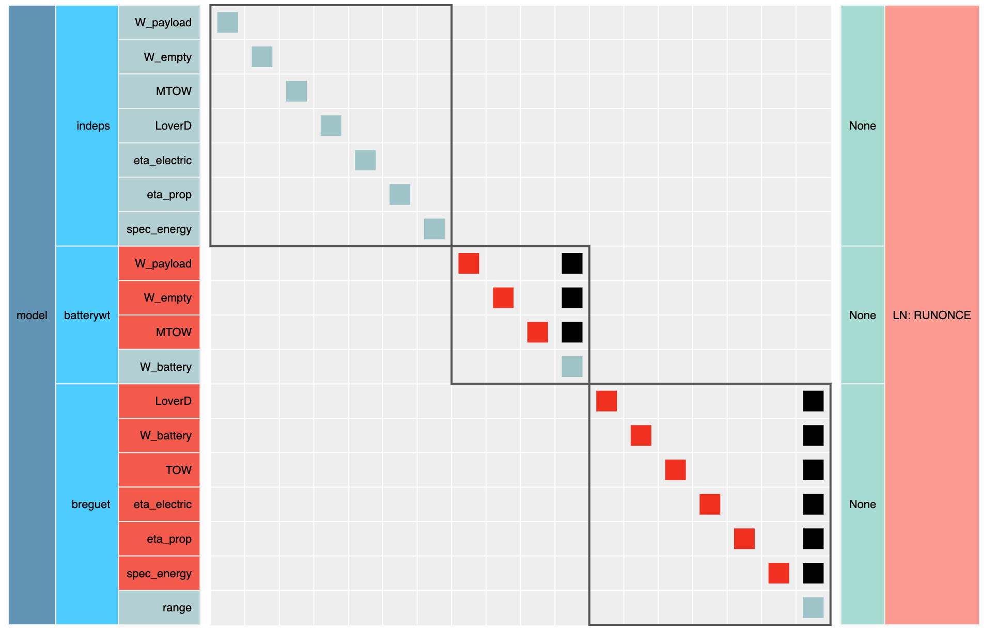
Lab 0.b: Aircraft Range
openmdao view_model lab_0.py
If you forgot any connections, you’ll see some red
All the red boxes represent unconnected inputs to components. Use explicit connection or variable promotion to get rid of all the red

Slide 61
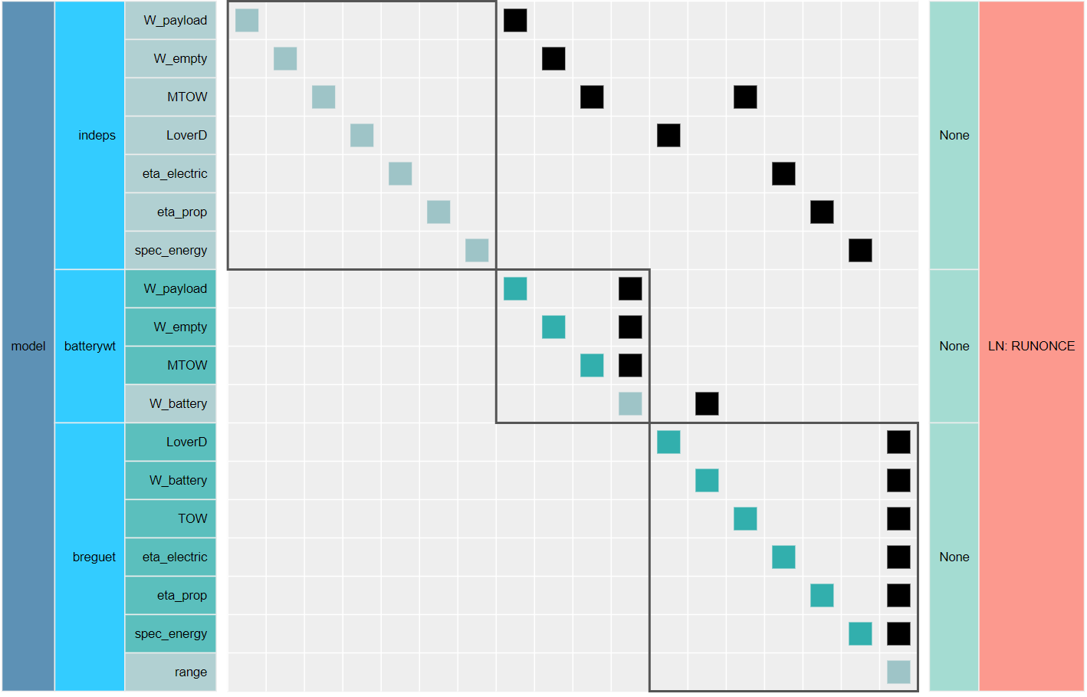
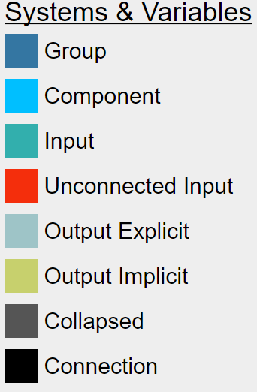
Lab 0.b: The n2 is your best friend!
Model hierarchy (groups,
components, variables)
Linear and nonlinear solver hierarchy
(more on this later…)
Connections!
Inside a box is within a single component

Slide 62
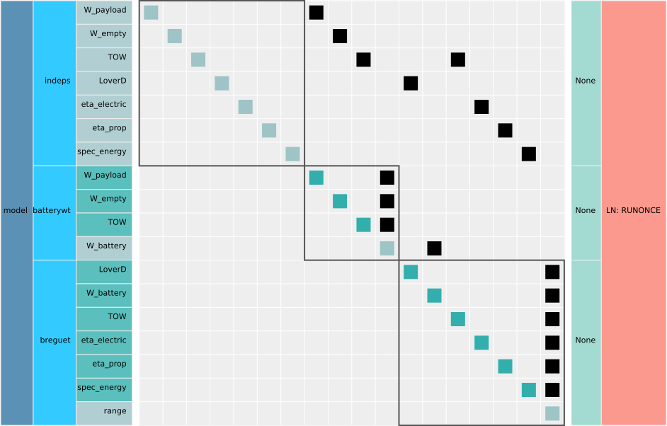
Lab 0.b: Aircraft Range
It should look like this!
This diagram is interactive:
Right click on the components/groups to collapse and expand them
Click on any black colored square to trace connections between components
N2 diagram is upper-triangular:
Pure explicit computation (feed-forward)

Slide 63
Lab 0 summary:
Everything we just did we can do faster in Excel.
This is a tutorial so the models are extremely simple and cheap, but …
Real-world models have hierarchies of dozens or hundreds of logical components
Real-world models often lack a closed form solution and require some kind of solver or iteration strategy

Slide 64
Using solvers with implicit models
Gradient-free solver: Nonlinear Block Gauss-Seidel (i.e. Fixed point iteration)
Gradient-based solver: Newton’s Method
Lab 1: Simple aircraft sizing and experimenting with different solver algorithms

Slide 65
OpenMDAO Nonlinear Solvers
When a circular dependency is detected, OpenMDAO needs a solver to converge the problem:
Choice #1: NonlinearBlockGS()
Choice #2: NewtonSolver()
Choice #3: BroydenSolver()
Choice #4: NonlinearBlockJac()

Slide 66
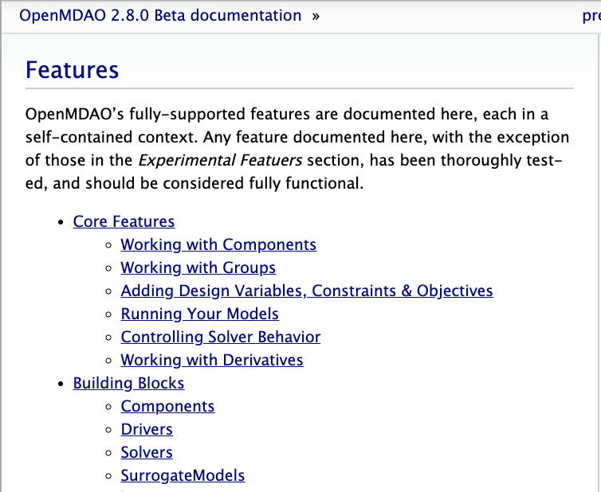
Check out the docs for more info!
Look at the docs for OpenMDAO’s standard library:
Lots of details on all the different solvers!

Slide 67
Check out the docs for more info!
Look at the docs for OpenMDAO’s standard library:
Lots of details on all the different solvers!
Also see sections for surrogates and helpful general purpose components!

Slide 68
Nonlinear Block Gauss-Seidel (Deriv Free)
Model 1
Model 2
Model 3
Cycle connection

Slide 69
Nonlinear Block Gauss-Seidel
Model 1
Run Model 1, give outputs to Model 2
Model 2
Model 3
Cycle connection

Slide 70
Nonlinear Block Gauss-Seidel
Model 1
Model 2
Run Model 2, give outputs to Model 3
Model 3
Cycle connection

Slide 71
Nonlinear Block Gauss-Seidel
Model 1
Model 2
Model 3
Run Model 3, give outputs to Model 1
Cycle connection

Slide 72
Nonlinear Block Gauss-Seidel
Model 1
Run Model 1, give outputs to Model 2
Model 2
Model 3
Cycle connection

Slide 73
Nonlinear Block Gauss-Seidel
Model 1
Model 2
Run Model 2, give outputs to Model 3
Model 3
Cycle connection

Slide 74
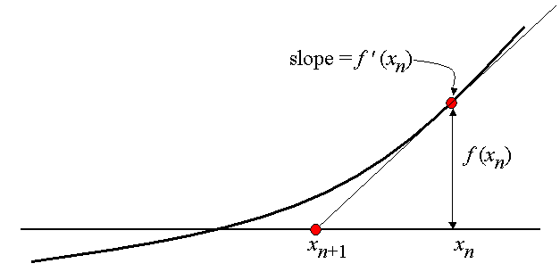
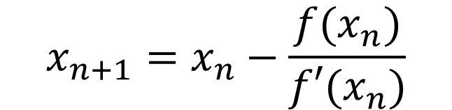
Newton’s Method is simple in one dimension (Requires derivs)
$$x_{n+1}=x_{n}−\frac{f(x_{n})}{f′(x_{n})}$$

Slide 75
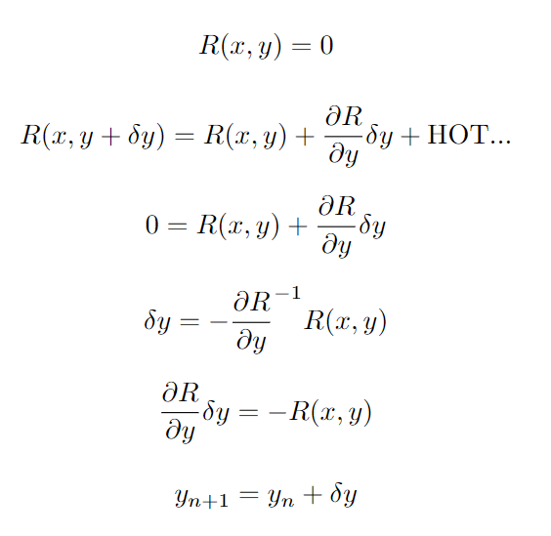
Newton Solver for multiple dimensions is a bit more complex
We want to drive residuals to 0
x: design variables
y: implicit state variables
n_{y}
1
1
Do a Taylor series with respect to the current point
We want residuals to be 0 at the next iteration y + dy
n_{y}
=
n_{y}
Solve for dy that would drive the linearize residuals to 0
Solve this linear system
Then take a step. Repeat until converged

Slide 76
Newton Solver needs some partial derivatives!
n_{y}
1
1
n_{y}
=
n_{y}

Slide 77
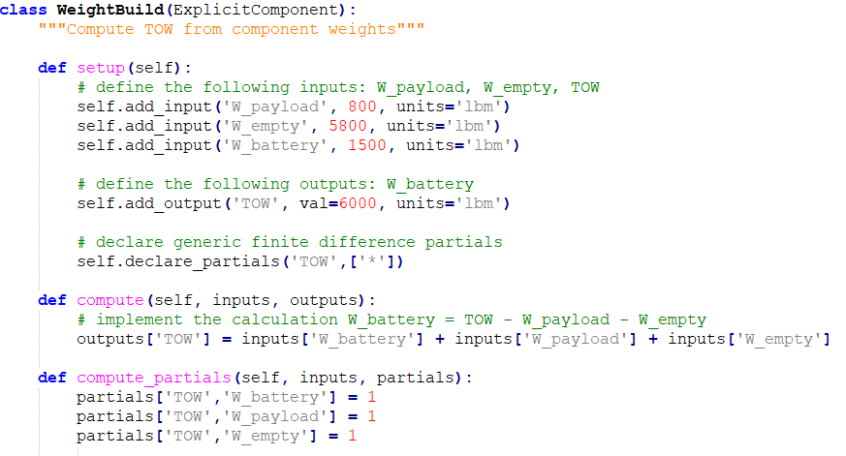
Partial Derivatives in OpenMDAO
OpenMDAO assembles the Jacobian for you, from provided component partials
This tells OpenMDAO which partials exist
This tells OpenMDAO the actual values of the partials
Define analytic derivatives:
partials(<of>, <with respect to>)

Slide 78
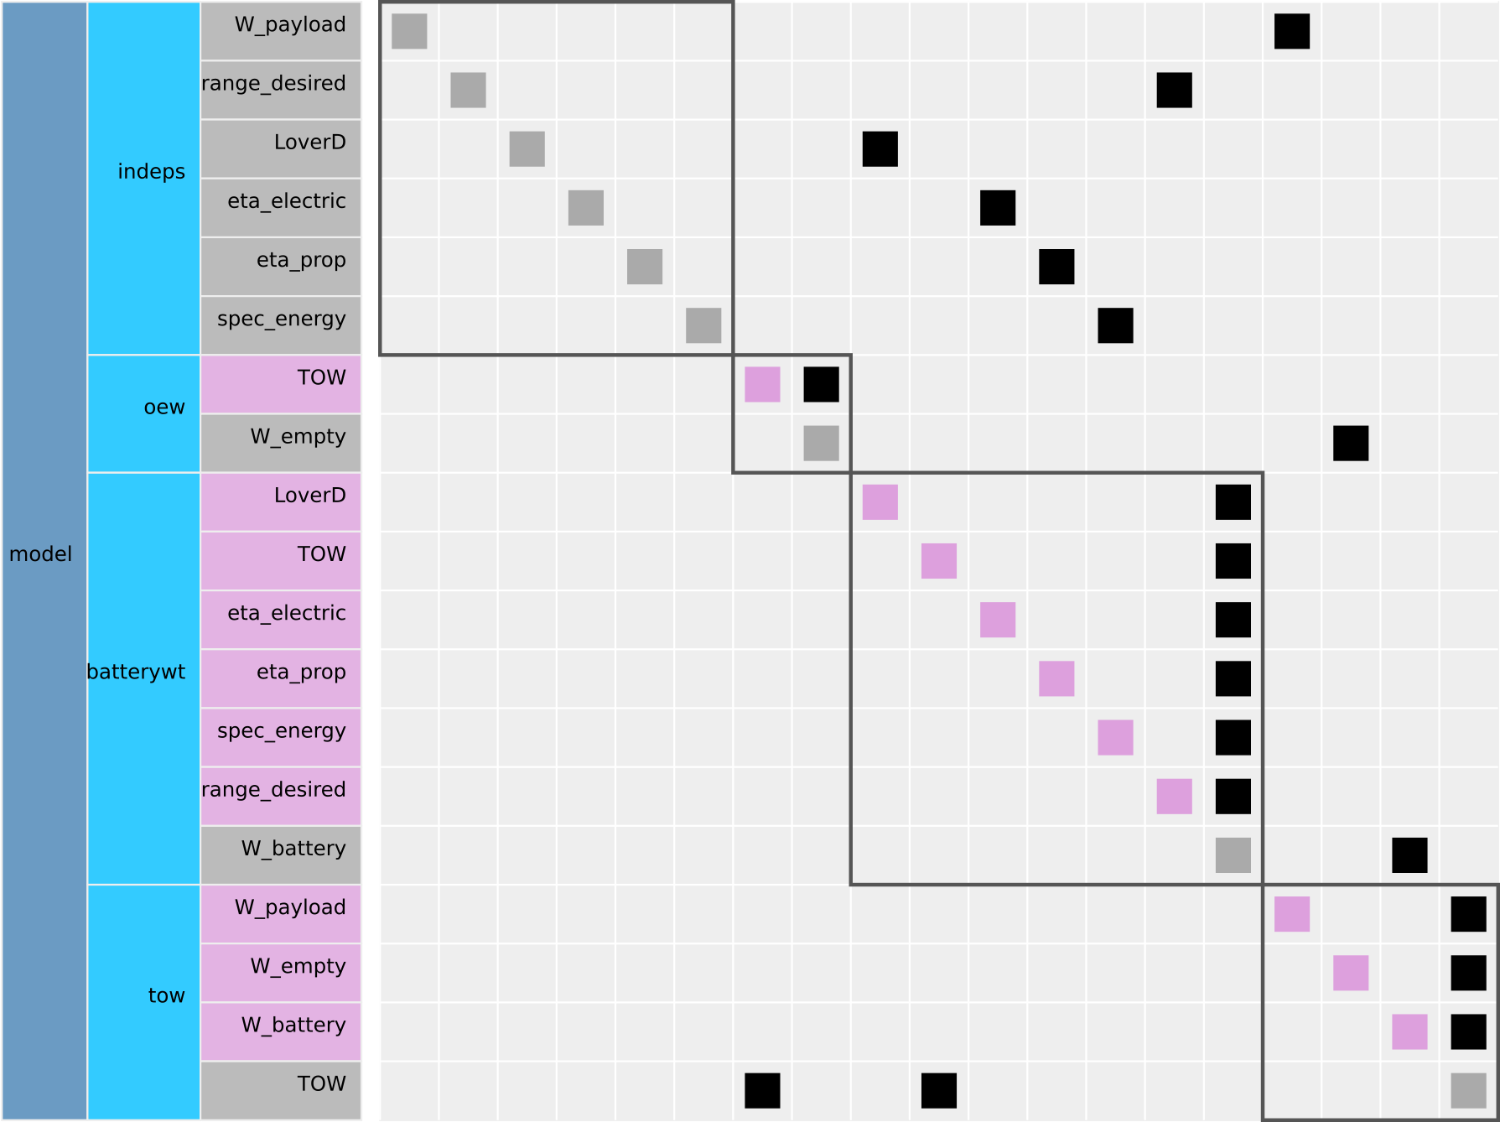
Lab # 1 : Aircraft Sizing
Next, we will “size” an electric aircraft for desired range
Open lab_1_template.py in a text editor or IDE and rename lab_1.py
Check the model by building an N2 diagram
This system is implicit (because it has a cycle) but has no implicit components

Slide 79
Lab # 1 : Aircraft Sizing
Run the model as-is using NLBGS (python lab_1.py)
The numbers that print out are the absolute and relative residuals
Change the empty weight fraction to 0.55
check out the ExecComp
Try using the Newton solver (~ Line 124). What happens?
Check your partial derivatives (~ Line 173)
Fix the partial derivatives of the incorrect components
Which solver uses fewer iterations?
Print all the inputs and outputs (~ Line 178, 179)

Slide 80
check_partials output
------------------------- Component: ExecComp 'oew' ------------------------- '<output>' wrt '<variable>' | fwd mag. | check mag. | a(fwd-chk) | r(fwd-chk) ------------------------------------------------------------------------------- 'W_empty' wrt 'TOW' | 6.0000e-01 | 6.0000e-01 | 2.3842e-08 | 3.9736e-08 ------------------------------------ Component: BatteryWeight 'batterywt' ------------------------------------ '<output>' wrt '<variable>' | fwd mag. | check mag. | a(fwd-chk) | r(fwd-chk) ----------------------------------------------------------------------------------- 'W_battery' wrt 'LoverD' | 0.0000e+00 | 9.6353e+01 | 9.6353e+01 | 1.0000e+00 >ABS_TOL >REL_TOL 'W_battery' wrt 'TOW' | 0.0000e+00 | 3.2118e-01 | 3.2118e-01 | 1.0000e+00 >ABS_TOL >REL_TOL 'W_battery' wrt 'eta_electric' | 0.0000e+00 | 2.0946e+03 | 2.0946e+03 | 1.0000e+00 >ABS_TOL >REL_TOL 'W_battery' wrt 'eta_prop' | 0.0000e+00 | 2.3218e+03 | 2.3218e+03 | 1.0000e+00 >ABS_TOL >REL_TOL 'W_battery' wrt 'range_desired' | 0.0000e+00 | 1.2847e+01 | 1.2847e+01 | 1.0000e+00 >ABS_TOL >REL_TOL 'W_battery' wrt 'spec_energy' | 0.0000e+00 | 6.4235e+00 | 6.4235e+00 | 1.0000e+00 >ABS_TOL >REL_TOL ---------------------------- Component: WeightBuild 'tow' ---------------------------- '<output>' wrt '<variable>' | fwd mag. | check mag. | a(fwd-chk) | r(fwd-chk) ------------------------------------------------------------------------------- 'TOW' wrt 'W_battery' | 7.5000e+01 | 1.0000e+00 | 7.6000e+01 | 7.6000e+01 >ABS_TOL >REL_TOL 'TOW' wrt 'W_empty' | 7.5000e+01 | 1.0000e+00 | 7.6000e+01 | 7.6000e+01 >ABS_TOL >REL_TOL 'TOW' wrt 'W_payload' | 7.5000e+01 | 1.0000e+00 | 7.6000e+01 | 7.6000e+01 >ABS_TOL >REL_TOL ########################################################### Sub Jacobian with Largest Relative Error: WeightBuild 'tow' ########################################################### '<output>' wrt '<variable>' | fwd mag. | check mag. | a(fwd-chk) | r(fwd-chk) ------------------------------------------------------------------------------- 'TOW' wrt 'W_battery' | 7.5000e+01 | 1.0000e+00 | 7.6000e+01 | 7.6000e+01

Slide 81
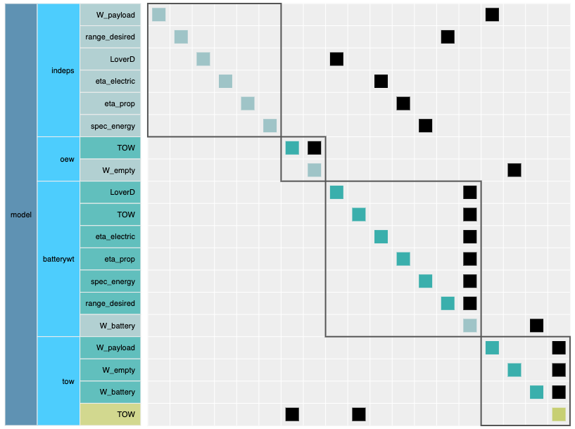
Lab # 1 : Aircraft Sizing continued
Switch back to the Gauss-Seidel solver
Switch to the WeightBuildImplicit component
solves for TOW by forcing design range equal to analyzed range
What happens when you run the model? Why?
Try the Newton solver

Slide 82
Optimization with and without analytic derivatives
High level introduction to different methods of computing derivatives
Lab 2: Optimization of a FEM for a cantilever beam

Slide 83
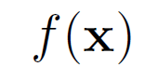
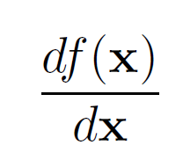
Optimization
OpenMDAO is capable of evaluating DOEs just like ModelCenter, but…
Gradient based optimization is A LOT faster!
So we need total derivatives across the whole model:
??

Slide 84
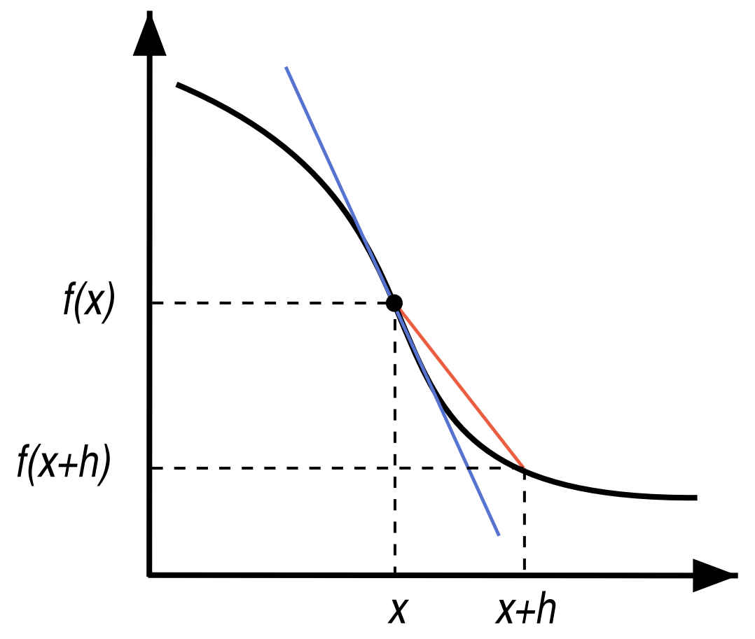
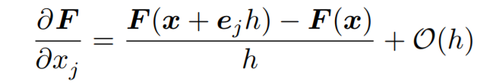
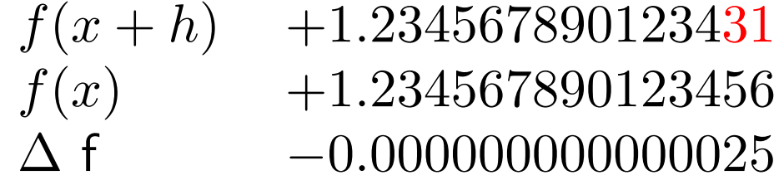
Finite difference is easy

Slide 85
Finite difference is easy, but…
Treats your model as a black-box
Expensive
Accuracy can be bad, especially close to the optimal point

Slide 86
It’s not a good idea to finite difference across solvers
Seriously… don’t do this unless you really have to.
It’s expensive (make your solver tolerances really tight)
It’s inaccurate
It will probably make your optimization converge slowly!
Lots of papers on this topic:
E. S. Hendricks and J. S. Gray, “Pycycle: a tool for efficient optimization of gas turbine engine cycles,” Aerospace, vol. 6, iss. 87, 2019.
E. S. Hendricks, “A multi-level multi-design point approach for gas turbine cycle and turbine conceptual design,” PhD Thesis, 2017.
J. S. Gray, T. A. Hearn, K. T. Moore, J. Hwang, J. Martins, and A. Ning, “Automatic Evaluation of Multidisciplinary Derivatives Using a Graph-Based Problem Formulation in OpenMDAO,” in 15th AIAA/ISSMO Multidisciplinary Analysis and Optimization Conference, 2014.
J. S. Gray, K. T. Moore, T. A. Hearn, and B. A. Naylor, “Standard Platform for Benchmarking Multidisciplinary Design Analysis and Optimization Architectures,” AIAA Journal, vol. 51, iss. 10, p. 2380–2394, 2013.
C. Marriage and Martins, J. R. R. A. “Reconfigurable Semi-Analytic Sensitivity Methods and MDO Architectures Within the πMDO Framework”, in Proceedings of the 12th AIAA/ISSMO Multidisciplinary Analysis and Optimization Conference, Victoria, BC, 2008.

Slide 87
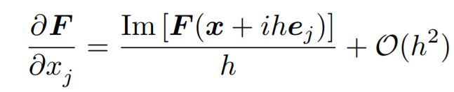
Complex step is more accurate than FD, but…
Treats your models as a gray-box (might require code modification)
Even more expensive
Some functions are tricky…
min(), max(), abs() can cause issues
[Martins et al., ACM TOMS, 2003]

Slide 88
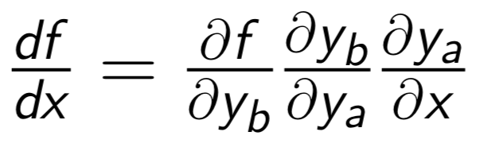
Analytic derivatives are both fast and accurate!

Slide 89
What about models with coupling?

Slide 90
How do you differentiate through this convergence loop?
We’ll need a nonlinear solver to converge this coupling.
The solver loop changes the way you compute analytic derivatives

Slide 91
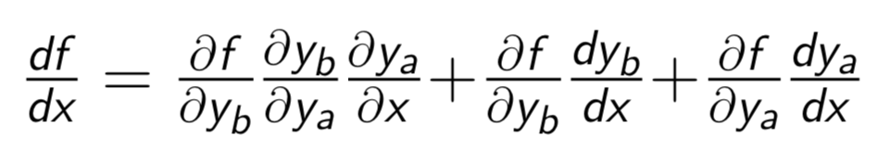
Manually computing analytic derivatives for coupled models takes a lot of work

Slide 92
How do compute these extra terms?
These terms will be computed using adjoints!

Slide 93
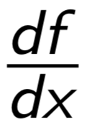
When models get really big … have fun!
= ???
Lets be honest, this just isn’t going to happen!

Slide 94
OpenMDAO can compute these total derivatives for you, automatically!
= [ask OpenMDAO]
For a deep dive on the math:
[Martins and Hwang 2013]
[Hwang and Martins 2018]

Slide 95
OpenMDAO splits total derivative computation into two steps
Computing the partial derivatives for each component
Solving a linear system for total derivatives

Slide 96
OpenMDAO splits total derivative computation into two steps
Computing the partial derivatives for each component
Numerical approach: FD/CS
Analytic approach: hand derivation or algorithmic differentiation
Mix and match numerical and analytic
You are responsible for this step, but OpenMDAO can help you a bit

Slide 97
OpenMDAO splits total derivative computation into two steps
1) Computing the partial derivatives for each component
2) Solving a linear system for total derivatives OpenMDAO does this automatically using a library of different linear solvers for different problems

Slide 98
By using OpenMDAO’s analytic derivative functionality you can
Efficiently solve optimization problems with 1000’s of design variables or thousands of constraints
Get total derivatives across a complicated model, by providing only partial derivatives of each component
Mix and match different techniques for computing partial derivatives

Slide 99
Rules of thumb for computing partials
Fine to start out with FD partials while getting your model set up!
For cheap black-box codes:
FD might be ok for production runs
CS is better if you can do it!
For “expensive” codes (anything with an internal solver):
Implement as ImplicitComponent (expose the states/residuals to OpenMDAO)
Can still FD the residual if you need to
Analytic derivatives typically cost a lot for these components

Slide 100
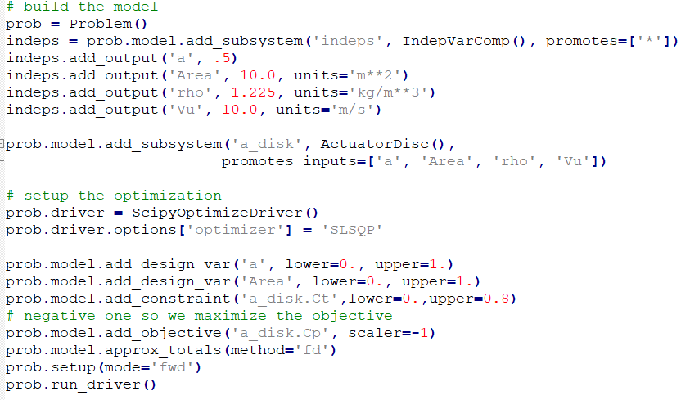
Optimization
Optimization is handled by a Driver
ScipyOptimizeDriver is what most people will use on Windows
add_design_var(<var_name>, lower=…, upper=…)
add_constraint(<var_name>, lower=…, upper=…)
add_objective(<var_name>)
run_driver instead of run_model

Slide 101
Optimization
Available drivers:
ScipyOptimizeDriver will work in Anaconda
Works on Windows machines
SLSQP method is the standard constrained opt in OpenMDAO
PyoptSparseDriver is much better (SNOPT algorithm) but really only builds on Linux/MacOSX (hard to build on windows, but technically is possible)

Slide 102
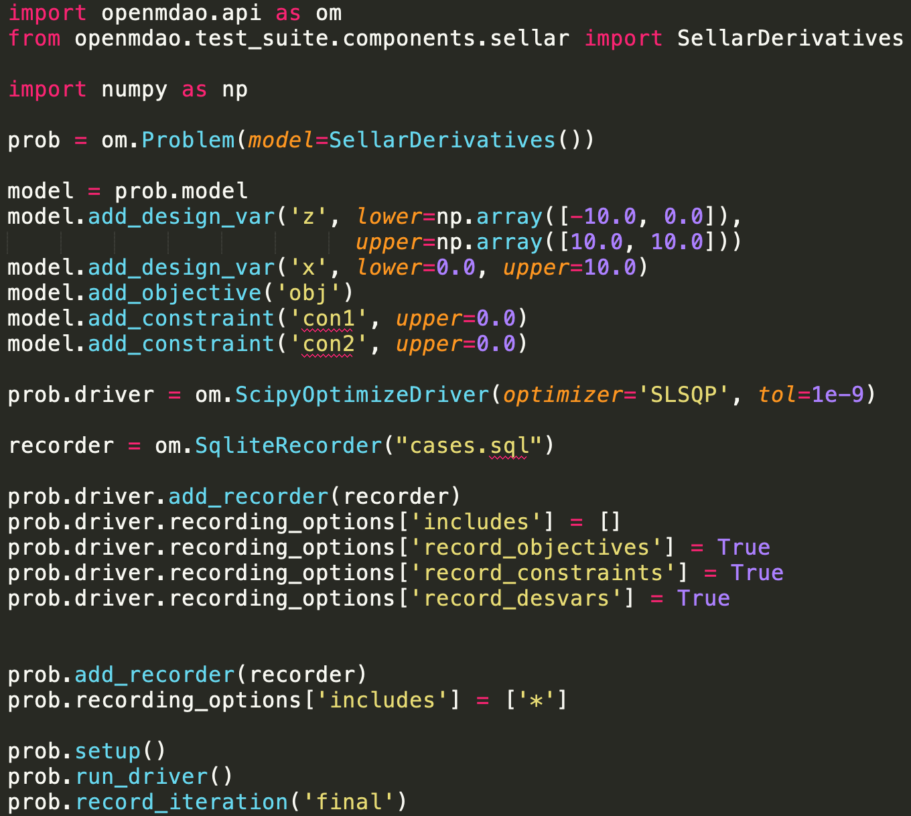
Recording the optimization history
Often you will want to record variable values changing over the course of an optimization.
This is achieved using a “recorder” object
This will record all the objective, all constraints, and all DVs for each optimizer iteration (but no “intermediate variables”)
Can then read in the data to postprocess

Slide 103
Saving all the variables for the final optimized point
We don’t normally save all the variables for every iteration to avoid making huge database files
This configures a secondary case type to record specific runs with all the variables

Slide 104
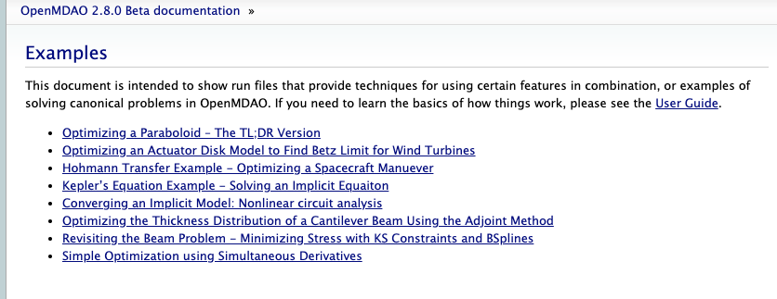
Lab #2: Optimization of a cantilever beam
Find the thickness distribution for a cantilever beam that minimizes compliance subject to a volume constraint
Check out the other examples on your own!
F

Slide 105
Lab #2: Simple FEM in 5 steps!
0) Break the beam into segments (0 doesn’t count as a real step!)
Compute the moment of inertia for each segment
Compute the local stiffness matrix for each segment
Combine all the local stiffness matrices into a global K matrix and solve the FEM
Pull displacements from the state vector and compute compliance
Compute beam volume

Slide 106
Lab #2: Pay close attention to step 4!
0) Break the beam into segments (0 doesn’t count as a real step!)
Compute the moment of inertia for each segment
Compute the local stiffness matrix for each segment
Combine all the local stiffness matrices into a global K matrix and solve the FEM
Pull displacements from the state vector and compute compliance
Compute beam volume
using the src_indices argument to the connect method,
you can extract just the relevant portion of the state vector for the
compliance calculation

Slide 107
Lab #2: Get to it!
Copy the “lab_2_template.py” file to a new file called “lab_2.py”
Add components in the correct order (~ line 40)
Connect the components together (~line 48)
Use the N2 diagram to make sure you have everything connected (no red inputs!)
What happens if you switch to full model FD? Does it work? Try changing the FD step size…
What about complex step?
How does compute cost scale with num_elements for different methods of computing derivatives?
What happens if you add the components in the incorrect order?

Slide 108
Wrapping external codes
How to handle file wrappers with OpenMDAO’s built in helper components
Lab 3: Explicit and Implicit file wrappers

Slide 109
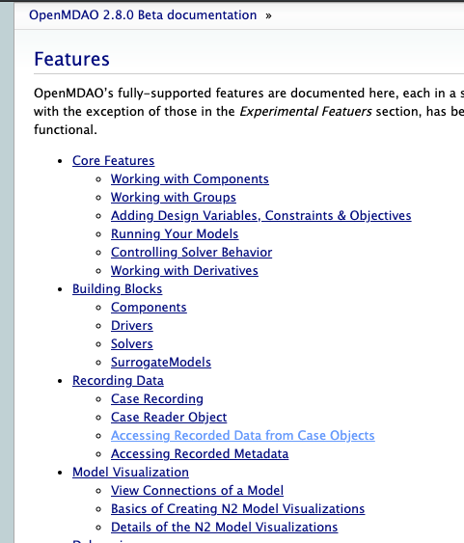
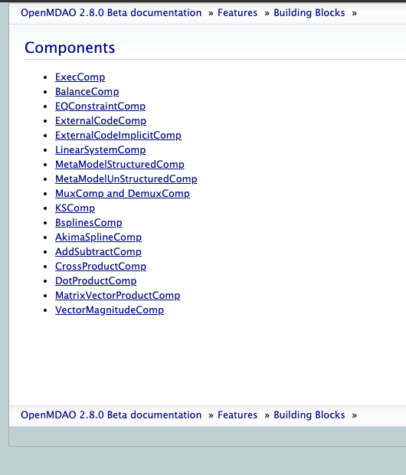
OpenMDAO has two file wrapper components in the standard library
There are lots of useful components
In the standard library!
spines, constraint aggregation,
file wrappers, Ax=b, Ax, etc…
Have a look through these comps,
So you know whats there

Slide 110

ExternalCodeComp
Inherit from OpenMDAO provided class
Define the I/O like normal
Wrapper specific options
Write the input file
Create a sub-process to run the code
Parse the output file
Push the values back into
OpenMDAO’s output vector

Slide 111

ExternalCodeImplicitComp
Inherit from OpenMDAO provided class
(different base class then for the explicit case!)
Define the I/O like normal
Wrapper specific options
Write the input file
apply_nonlinear is the
Residual evaluation
Create a sub-process to run the code
Parse the output file
solve_nonlinear asks the
code to converge itself using
its own internal solvers

Slide 112
Lab #3: Beam optimization with file wrapped external codes
cd into the `lab_3` folder
Have a quick look at standalone_beam.py this is a pure python version of the same FEM you built in OpenMDAO for Lab #2 (but without derivatives)
Call `python standalone_beam.py opt` from the command line
Call `python lab_3_explicit_wrapper.py`
Call `python lab_3_implicit_wrapper.py`
Why does the implicit wrapper call both solve_nonlinear and apply_nonlinear? (hint: it has to do with derivatives)
Compare the compute cost of running the optimization using pure OpenMDAO, the standalone optimization, and the file wrapped version.

Slide 113
Advanced Topics
Model architecting
Vectorization
Implicit components
Getting system derivatives efficiently
High-fidelity and expensive tools
Debugging tools and processes
Surrogate modeling
Trajectory optimization
Propulsion analysis

Slide 114
Model architecting
Developing good OpenMDAO models is like object-oriented software engineering: you need to pick the right level to draw the component boundary
In my opinion, a good component has:
on the order of 5 – 20 inputs
1 – 20 outputs
a few computations that are logically related
Python’s package import system makes this easy
Real-world examples:
https://github.com/mdolab/OpenConcept
https://github.com/mdolab/OpenAeroStruct

Slide 115

Model architecting example

Slide 116
Vectorization
Where possible, avoid instantiating models over and over for multi-point analyses (e.g. trajectory optimization)
Instead, do vectorized computations using numpy
OpenMDAO needs to know the dimension of all component inputs / outputs at setup() time
Best practice: pass in vector length as a self.option[‘vec_size’]
If you mess this up you’ll get dimension mismatch errors at run time

Slide 117

Vectorization
User sets vector dims when instantiating the model
shape=(dim1, dim2,…)
Sparse Jacobian indices for vector input and vector output
Sparse Jacobian indices for scalar input and vector output

Slide 118

Vectorization
Many flight conditions computed at once using vectorized computation

Slide 119

Implicit Components
Useful for computations where there isn’t an easily written explicit expression
$\cos\left(x⋅y\right)−z⋅y=0$ y is a state and x,z are inputs
CFD or FEA analyses
You compute the residuals for the states instead of the outputs directly
Implicit components always require a solver
http://openmdao.org/twodocs/versions/latest/advanced_guide/implicit_comps/defining_icomps.html

Slide 120

Getting system derivatives efficiently: automatic Jacobian coloring
http://openmdao.org/twodocs/versions/latest/features/core_features/working_with_derivatives/simul_derivs.html

Slide 121

Getting system derivatives efficiently: automatic Jacobian coloring

Slide 122
High-fidelity and expensive tools
OpenMDAO can handle a mix of fidelity levels easily
Can parallelize at the group or subgroup level
Only requiring the partial derivatives becomes quite important here

Slide 123

High-fidelity and expensive tools

Slide 124


High-fidelity and expensive tools
[Hwang et al., AIAA 2019-1.C035082]

Slide 125
High-fidelity and expensive tools

Slide 126
Debugging tools
Many tools come pre-packaged in OpenMDAO to help you develop, debug, and run your models
N2
Connection viewer
Speed and memory profiling
Call tracing
http://openmdao.org/twodocs/versions/latest/other/om_command.html

Slide 127

Connection viewer: openmdao view_connections <file.py>

Slide 128

Speed and memory profiling: openmdao iprof <file.py>

Slide 129

Call tracing: openmdao call_tree <method>

Slide 130
Surrogate modeling
Built-in methods for structured and unstructured data interpolation
Kriging surrogate
Nearest neighbor
Response surface
http://openmdao.org/twodocs/versions/latest/features/building_blocks/components/metamodelunstructured_comp.html

Slide 131

Surrogate modeling

Slide 132

Trajectory optimization: Dymos
Dymos is a tool built using OpenMDAO that solves optimal control problems involving multidisciplinary system
Example optimal trajectory for an aircraft climb shown on right
http://github.com/openmdao/dymos

Slide 133

Propulsion optimization: PyCycle
E. S. Hendricks and J. S. Gray, “Pycycle: a tool for efficient optimization of gas turbine engine cycles,” Aerospace, vol. 6, iss. 87, 2019.
https://github.com/openmdao/pycycle

Slide 134
Recap of today’s activities
OpenMDAO intro and basics
Lab 0: Explicit components and connections
Using solvers with implicit models
Lab 1: Comparing gradient-free and gradient-based solvers
Optimization with and without analytic derivatives
Lab 2: Optimizing the thickness distribution of a simple beam
Wrapping external codes
Lab 3: Wrapping external codes as explicit and implicit components
Advanced topics

Slide 135



Tusen takk!

Slide 136
Tusen takk!
Subscribe to MDO Lab e-mail updates by sending a blank e-mail to:
engopt-join@mdolab.engin.umich.edu
http://mdolab.engin.umich.edu/

